Slide 1



How did We Come to Microservices? History and Driving Forces Audience: All

Slide 2
Introduction
How did We Come to Microservices?
Who I am: <Instructor Name>
Title
Organization
Role
Background

Slide 3
Agenda
Microservices Prerequisites
Microservices – History, Driving Forces, and Definition
Microservices Patterns
DevOps
Reactive Microservices
1
5
9
13
AD
All
D
AD
A
Microservices Prerequisites
Integration
Securing Microservices
Testing
2
6
10
14
AD
AD
A
D
A
A
Spring Boot
Migrating Monoliths to Microservices
Domain Driven Design Testing
Scaling Microservices
3
7
11
15
AD
D
A
A
A
Case Study
Cloud
UI
Microservices Anti-Patterns
4
8
12
16
AD
AD
All
All
A
A
Legend: All Developer Advanced Developer Architect
All
D
AD
A

Slide 4

Objectives
How did We Come to Microservices?
At the end of this training, you should be able to:
Describe the challenges in operating environment that pave way for Microservices
Define Cloud, DevOps, and Agile, and how they work in tandem with Microservices

Slide 5
Topics
How did We Come to Microservices?
Driving forces for the move to Microservices
Cloud Complexity of Operating Environment Customer Expectations | Agile DevOps

Slide 6
Sneak Peek

Slide 7


Microservices
How did We Come to Microservices?
WHAT
Microservices is a style of architecting applications as a suite of isolated business oriented services that work together as “the application”.
Microservices are in contrary to ‘monoliths’ style, which clubs all services into a single application.
Microservice style essentially a distributed architecture that inherits the benefits and complexities of such an architecture.
WHY
Tackling complexity of modern applications
Running on Cloud and being Cloud Native
Smaller feedback loop, like Agile
Complexity of today’s operating environment
DevOps Culture

Slide 8
Driving Forces

Slide 9
Realities of Today’s Operating Environment
How did We Come to Microservices?
 | Till a few years back… | Now
Workloads | ~10’s | ~1000’s
SLA | Seconds | Milliseconds
Maintenance downtimes | Hours | None
data processing volume | GBs | PBs
Nature of Data | Mostly at Rest, Small | Majorly in Motion, Large
Connected Users | Millions | Billions
Processors | Single Core | Multi Core

Slide 10
Agile + DevOps Real-time - Enabled by Cloud
How did We Come to Microservices?
Agile with DevOps real-time development and deployment, and enabled by Cloud Technologies is transforming the organization’s ability to respond to customer needs and test innovative business ideas.
Cloud
DevOps
Agile
Infrastructure availability/Scaling/Resiliency
Cost effectiveness
Automated Operations
Continuous deployment
Distributed Monitoring
Business/IT Collaboration
Frequent Release
Continuous Integration

Slide 11
Cloud: Overview
How did We Come to Microservices?
Cloud computing is the delivery of computing services – including servers, storage, databases, networking, software, analytics, and intelligence – over the Internet.
Cloud offers faster innovation, flexible resources, and economies of scale.
Clients can choose to pay only for Cloud services they use – this helps lower operating costs, run infrastructure more efficiently, and scale as per changing business needs.
Cloud
Cloud

Slide 12
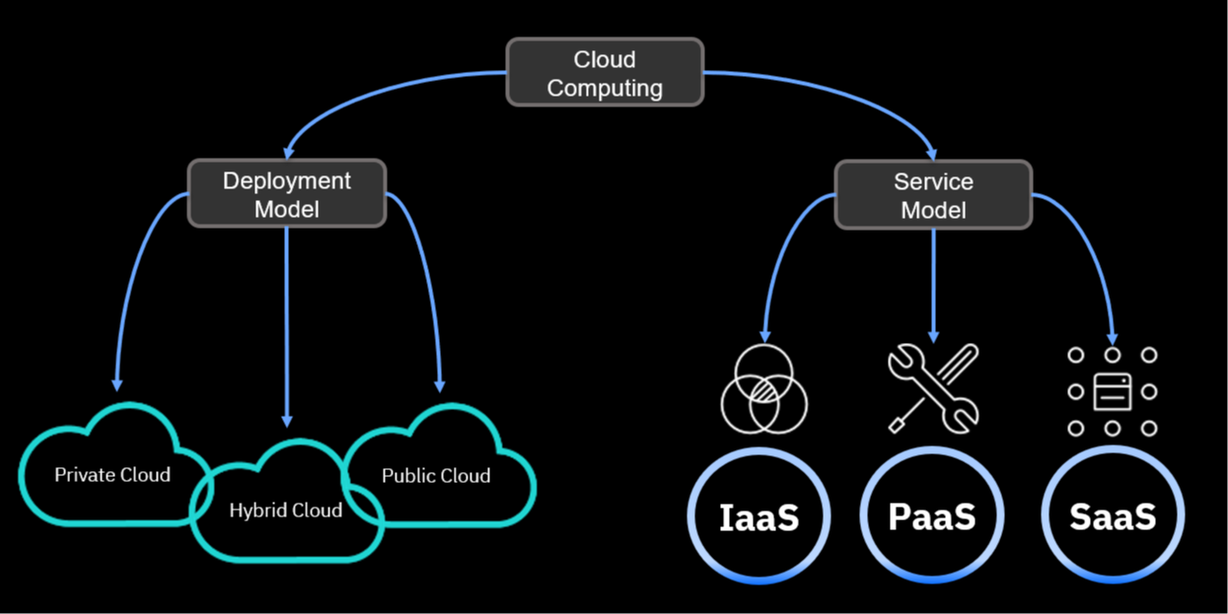
Cloud Model
How did We Come to Microservices?

Slide 13
Types of Cloud
How did We Come to Microservices?
Public Clouds
Whole computing infrastructure is located on the premises of a Cloud computing company that offers the Cloud services.
Private Clouds
All computing infrastructure is hosted at the client location and is not shared. The security and control level is highest while using a private network.
Hybrid Clouds
Both private and public Clouds are used – depending on their purpose. Clients host their most important applications on their own servers to keep them more secure.
Community Clouds
It is shared between organizations with a common goal or that fit into a specific community,
Public Clouds are owned and operated by a third-party Cloud service provider. These deliver their computing resources like servers and storage over the Internet. With a public Cloud, all hardware, software, and other supporting infrastructure is owned and managed by the Cloud provider. You access these services and manage your account using a web browser.
A Private Cloud can be physically located on the company’s on-site datacenter. Some companies also pay third-party service providers to host their private Cloud. A Private Cloud is one in which the services and infrastructure are maintained on a private network.
Hybrid Clouds combine public and Private Clouds, bound together by technology that allows data and applications to be shared between them. By allowing data and applications to move between private and public Clouds, a hybrid Cloud gives businesses greater flexibility and more deployment options, and helps optimize existing infrastructure, security, and compliance.
It is shared between organizations with a common goal or that fit into a specific community. A Community Cloud in computing is a collaborative effort in which infrastructure is shared between several organizations from a specific community with common concerns, for example, security, compliance, and so on, whether managed internally or by a third-party and hosted internally or externally.

Slide 14
Benefits of Cloud infrastructure adoption
How did We Come to Microservices?
Cost
Cloud computing eliminates the capital expense of buying hardware and software and setting up and running on-site datacenters; the racks of servers, the round-the-clock electricity for power and cooling, the IT experts for managing the infrastructure – it all adds up fast.
Speed
Most Cloud computing services are provided as self service and on demand, so even vast amounts of computing resources can be provisioned in minutes, typically with just a few mouse clicks. This gives businesses a lot of flexibility and takes the pressure off capacity planning.
Scale
The benefits of Cloud computing services include the ability to scale elastically.
Productivity
On-site datacenters typically require a lot of “racking and stacking”—hardware setup, software patching, and other time-consuming IT management chores. Cloud computing removes the need for many of these tasks, so IT teams can spend time on achieving more important business goals.
Performance
The biggest Cloud computing services run on a worldwide network of secure datacenters, which are regularly upgraded to the latest generation of fast and efficient computing hardware. This offers several benefits over a single corporate datacenter, including reduced network latency for applications and greater economies of scale.
Reliability
Cloud computing makes data backup, disaster recovery, and business continuity easier and less expensive because data can be mirrored at multiple redundant sites on the Cloud provider’s network.
Security
Many Cloud providers offer a broad set of policies, technologies, and controls that strengthen the security posture overall, thus helping protect data, apps, and infrastructure from potential threats.

Slide 15
Customer expectations
How did We Come to Microservices?
By definition, customer expectations are any set of behaviors or actions that individuals anticipate when interacting with a company. Historically, customers have expected basics like quality service and fair pricing.
However, modern customers have much higher expectations, such as proactive service, personalized interactions, and connected experiences across channels.
Disruptive companies leverage breakthroughs in Cloud, mobile, social, and artificial intelligence technologies to deliver personalized, valuable, and immediate experiences, hence, providing customers with more choices.
As a result, they grow to expect this superior experience from any business that they engage with.

Slide 16
Agile
How did We Come to Microservices?
Significance of Agile Microservice architecture
Agile development methodology ideally suited to Microservices
Digital transformation projects are executed in a world of growing uncertainties. This leads to the need to rapidly change or modify software implementations as our clients’ requirements shift.
Agile allows us to develop, package, and deploy isolated and self-contained parts of the overall software application individually.
In Microservices you have small teams working together, focused on specific areas. In much the same way, the Agile Manifesto recommends that successful and efficient teams are those that comprise of 6-8 people, who are empowered to make the necessary decisions.
Agile provides the structure for teams to work together effectively when handling applications on a Microservices architecture.

Slide 17
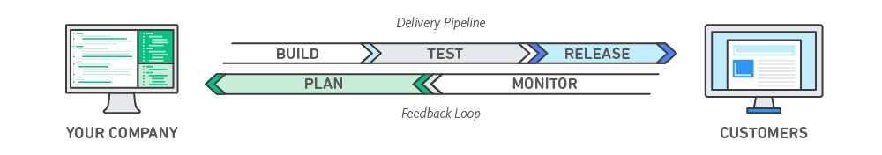
DevOps
How did We Come to Microservices?
DevOps is the combination of cultural philosophies, practices, and tools that increases an organization’s ability to deliver applications and services at high velocity, thus evolving and improving products at a faster pace than organizations using traditional software development and infrastructure management processes.
This speed enables organizations to better serve their customers and compete more effectively in the market.

Slide 18
Moving To Microservices

Slide 19
Reasons to shift to Microservices
How did We Come to Microservices?
Simple to develop, test, deploy, and scale
Reduces the complexity of writing large lines of code
Faster startup time - thanks to lightweight servers
Independent scaling of each service
Improves communication between Development, QA, and Testing teams
Embraces DevOps and automation
Easy to find bugs and address them quickly

Slide 20
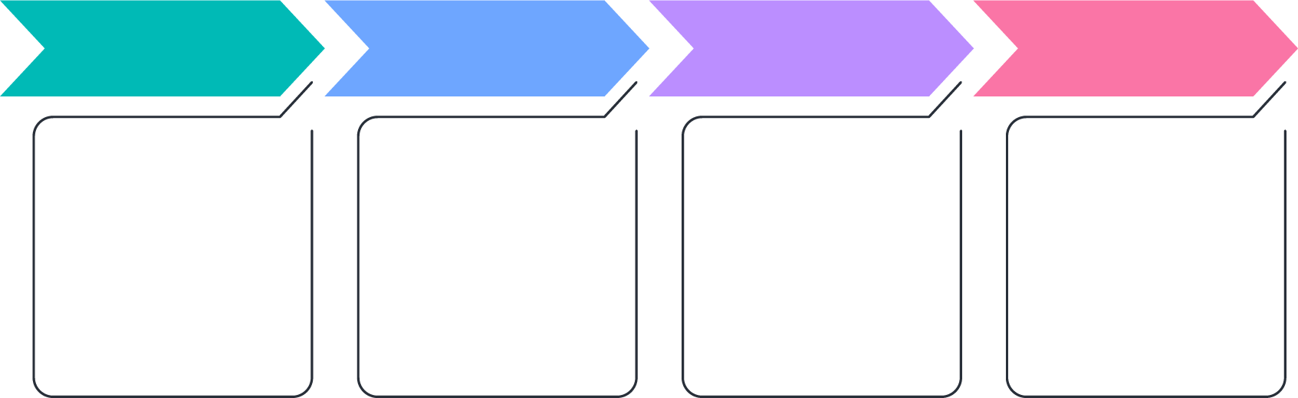
Moving to Microservices
How did We Come to Microservices?
Moving to Microservices from a monolith is a huge paradigm shift. A new culture needs to be built around how a team should handle and code their services.
This kind of transition is always incremental because it is hard to build and prepare everything beforehand. So, it is important to analyze and prioritize the base to begin with.
As the number of Microservices increases, managing them gets more challenging. It is important that management is planned before or while Microservices are being built.
While the modularity helps, things can very quickly get out of hand if not managed well. Many engineering leaders have stated that the mismanagement of these services is as much a problem as problems faced during the initial stages of the transformation from monolithic applications.

Slide 21
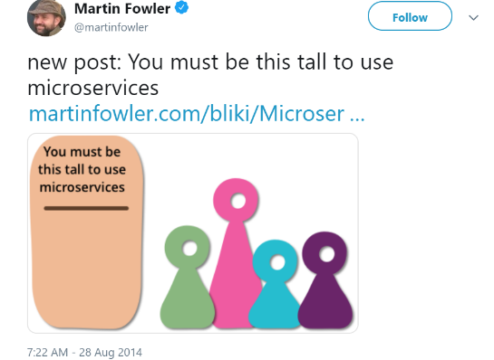
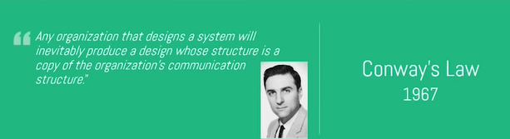
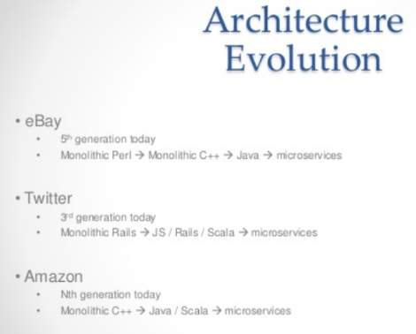

Before staring, few words from the wise
How did We Come to Microservices?

